Slide 1

Supervised word translator
MULTILINGUAL CoRPUS and words glossary analysis
Charlotte Durand – Laurene Bouskila- Jan Aymeric

Slide 2
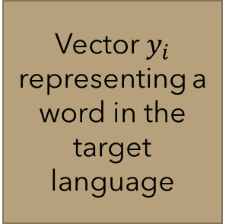
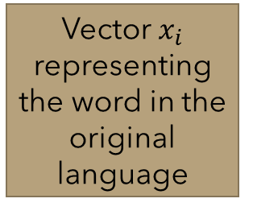
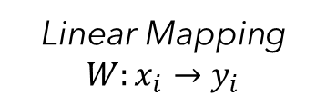
How to translate a Word
Based on a supervised approach
1 – Word embedding
2 – Computing the learning Mapping W
3 – Translation from French to English
4 – Alphabet influence on accuracy
Vector $y_{i}$ representing a word in the target language
Word translated in the target language
Vector $x_{i}$ representing the word in the original language
Previous vector after linear mapping
Word in the original language
Word embedding
Linear Mapping $W:x_{i}→y_{i}$
1-NN
Word embedding

Slide 3
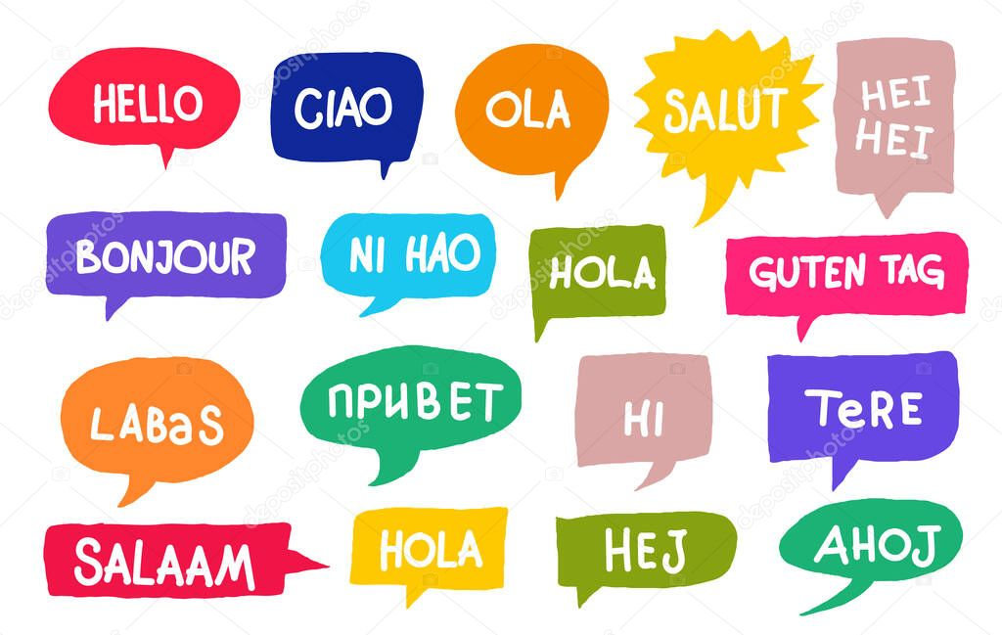
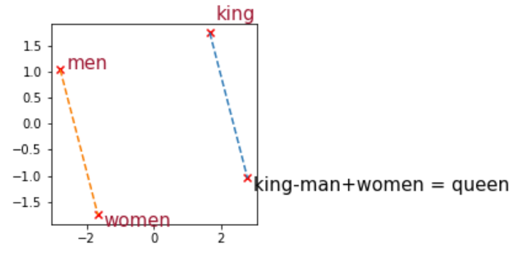
I] Word embedding
Word embedding is a technique that consists into the idea of mapping a words into an array of numbers. Generalizing to a larger scale: it creates a vector space of words where two words semantically close will also be computed as a vector with high similarity
This vector representation enables to perform mathematics operations on it (basic calculation, distance evaluation, linear algebra). Thus, it becomes possible to observe: its similarities to other words, its translation into another language, its belonging to a particular glossary of word, a logic consequence word out from two words eg: (“cat” + “cute’ -> “kitten”)

Slide 4


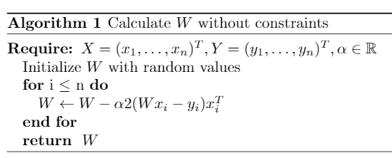
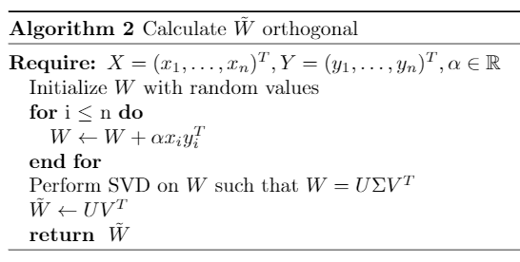
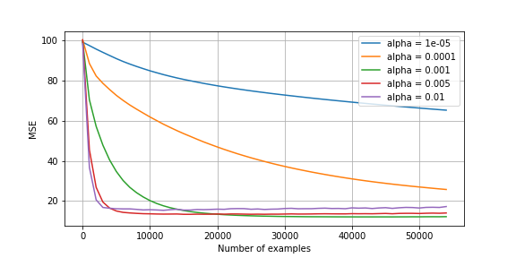
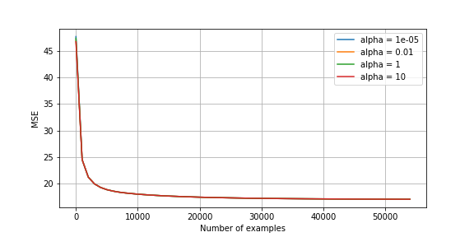
Computing the linear mapping W
Unconstrained Method Constrained Method
In a general case
If $W x_{i}$ and $y_{i}$ are normalized vectors, then

Slide 5
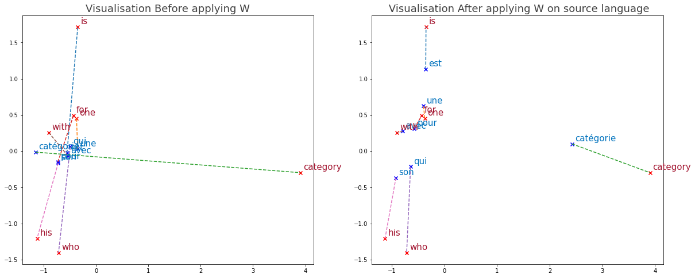
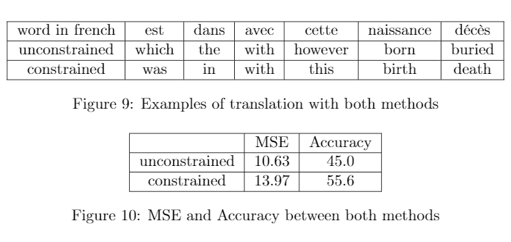
Translation from French to English
With a PCA we can see the effect of the linear mapping on the word space
Forcing W to be orthogonal provides a better accuracy, meaning a better translation

Slide 6
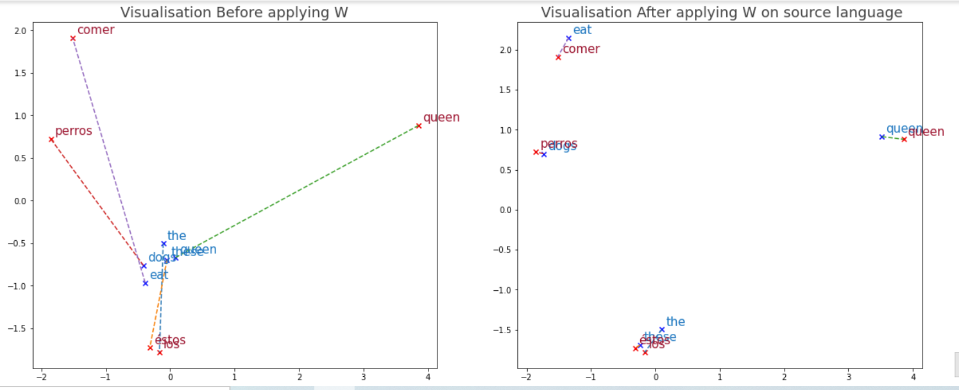
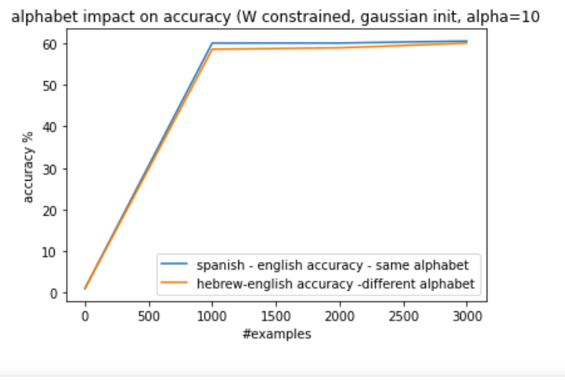
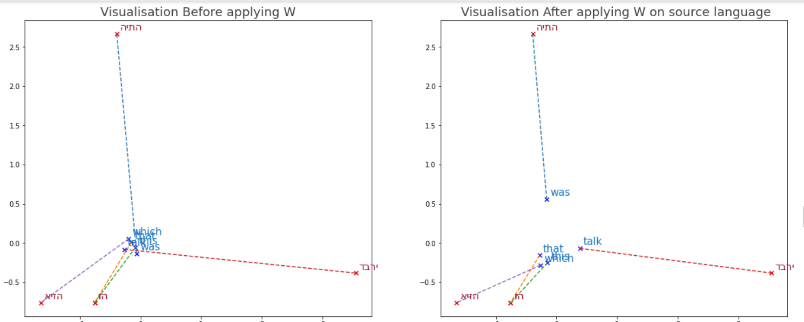
Alphabet influence on accuracy
There is a difference between different nature of langage : the closer the letter are the better is the translation.

